Slide 1
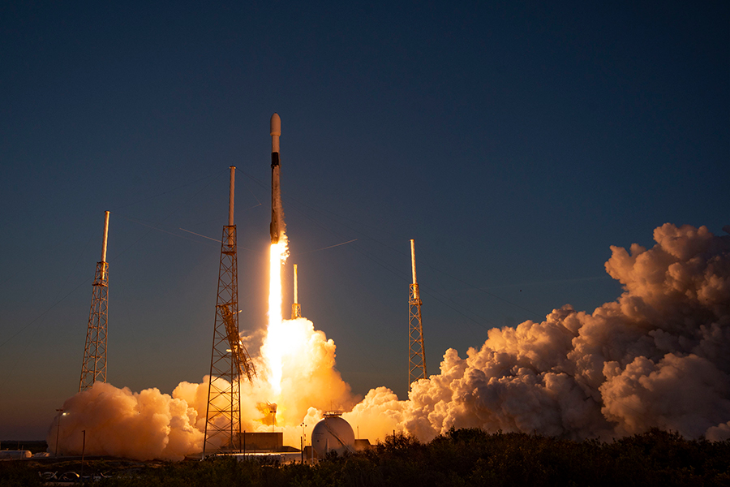

Data Science with SPACEY
Deep Doshi
17 March 2023

Slide 2
OUTLINE
Executive Summary
Introduction
Methodology
Results
Conclusion
Appendix

Slide 3
EXECUTIVE SUMMARY
The following methods were used in the analysis of the SpaceX Launch Data
Data collection using the SpaceX API and web-scrapping.
EDA, data wrangling, visualizations analysis and interactive visualization analytics were performed on the data.
Machine Learning models were built for making predictions for the success of a launch.
Results
Analysis of the data revealed that some features which were more useful in making predictions for a launch.
Multiple models were built and the best one was selected for the predictions.

Slide 4
INTRODUCTION
The objective is to evaluate the cost and the factors that would affect the success of the launches for a new rival company SpaceY.
Required Results
The location for the launch sites.
More information on the surroundings of these sites.
An efficient way to predict the success or failure of a launch and its cost.

Slide 5
METHODOLOGY
Data Collection:
Data was collection using 2 methods.
SpaceX API (https://api.spacexdata.com/v4/rockets/)
Web Scraping (https://en.wikipedia.org/wiki/List_of_Falcon/_9/_and_Falcon_Heavy_launches).
Data Wrangling.
Data was modified to have a result column denoting a launch's success (1) or failure (0).
Performed EDA on the data using SQL, Pandas, visualizations.
Success rates for different launch sites, orbits, payloads throughout the years.

Slide 6
METHODOLOGY
Generate interactive visualizations using Folium and interactive web apps using Plotly and Dash.
Launch Site analysis.
Success rates for a selected launch site and a range of payload mass.
Performing Predictive Analysis using Machine Learning.
Transformed data was normalized.
Divided into Test and Training sets.
The training set was used to build various models which were the compared based on their accuracy.

Slide 7
DATA COLLECTION
Data was requested from the SpaceX API.
SpaceX offers a public API using which we can obtain data on their rocket launch data.
The data was then filtered to focus only on the Falcon9 launches.
Missing values were handled by replacing them with mean and modes based on column types.
And it was also scrapped from the Wikipedia.
Same information is also present on Wikipedia page.
The page was requested using the BeautifulSoup package.
The HTML Tables were parsed to convert the values to create the data frames.

Slide 8
DATA WRANGLING
Analysis was performed on the data.
Success rates for different launch sites, orbits, payloads and throughout the years.
Finally, a result column was created that held the information about the success and failure of the launch.

Slide 9
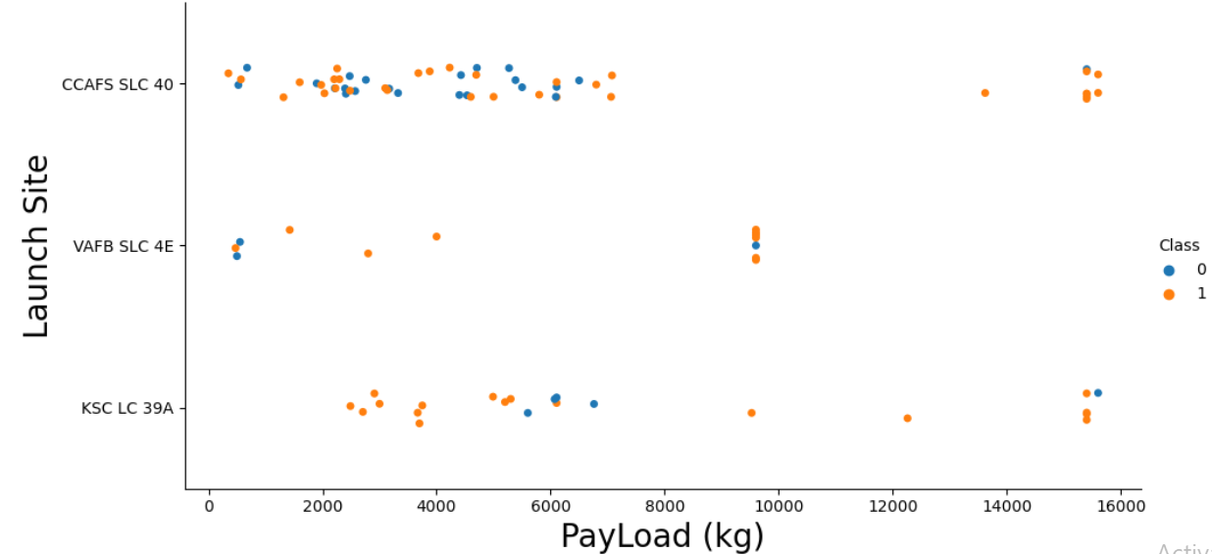
EDA with DATA VISUALIZATION
Exploration was performed using bar plots, scatter plots for understanding the relations between pairs of features.
The pairs of features were Launch Site and Payload, success rate and Orbit Types, Orbit Types and Flight Numbers etc.

Slide 10
EDA with SQL
Exploration on the data was also done using SQL. Following queries were performed:
The names of the unique launch sites.
5 launch sites that begin with the string 'CCA'.
Total payload mass carried by boosters launched by NASA (CRS).
Average payload mass carried by booster version F9 v1.1.
Date of the first successful landing outcome in ground pad.
Successful boosters in drone ship that have payload mass between 4000 and 6000.
Total number of successful and failure mission outcomes.
Names of the booster versions which have carried the maximum payload mass.
Failure for drone ship ,booster versions, launch site and months for the months in year 2015.
Rank the count of successful landing outcomes between the date 04-06-2010 and 20-03-2017 in descending order.

Slide 11
INTERACTIVE MAP Using FOLIUM
Folium maps with Circles, Markers, MarkerClusters, MousePositions were generated.
Circles are used to highlight areas surrounding the launch sites like Cape Canaveral Space Launch Complex 40 (CCAFS LC-40).
Markers are used to mark the co-ordinates of the launch sites.
Mouse Positions were used to calculate the co-ordinates of the location the mouse is pointing to on the map.
Lines were used to display the distance between the launch sites and other locations such as railways, coastlines and cities etc.

Slide 12
INTERACTIVE DASHBOARD Using DASH
Graphs were displayed on an Interactive UI to visualize the data.
Pie chart to display the success and failure rate of a selected Launch Site.
Payload range slider to select the launches in the specified range of payloads to analyze.
The dashboard allows effortless analysis of the relation between payload ranges, launch sites and their success and failure rates.

Slide 13
PREDICTIVE ANALYSIS Using ML
Built ML models to train on the data for prediction of launch success or failure.
Decision Tree
Logistic Regression.
Support Vector Machines
K Nearest Neighbours.
The data was standardized and split into training and testing sets.
Hyper-parameter optimization was done on the models to find the best parameters for the models.
The accuracy scores of the models were compared to select the best one.

Slide 14
RESULTS
EDA Results:
SpaceX uses 4 different launch sites. CCAFS LC-40, VAFB SLC-4E, KSC LC-39A, CCAFS SLC-40.
The average payload of F9 v1.1 booster is 2,928.4 kg.
The total payload of NASA Boosters is 45,596 kg.
The first successful ground pad landing was done on 1st May 2017.
Only 1 in-flight launch resulted in failure. Rest all were a success.
Only 2 drone ship failures were reported in the F9 v1.1 B1012 and F9 v1.1 B1015 boosters.
The success rate for the launches have increased over the years after the year 2013.

Slide 15
RESULTS
Interactive folium maps showed that most of the successful launches were near the coastlines away from cities in safety locations.
These locations also have sophisticated infrastructure such as railways.

Slide 16
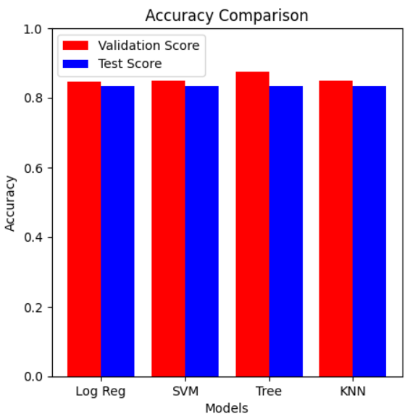
RESULTS
The predictive analysis revealed that the Decision Tree is the best model for the predictions as it had the highest accuracy score.

Slide 17
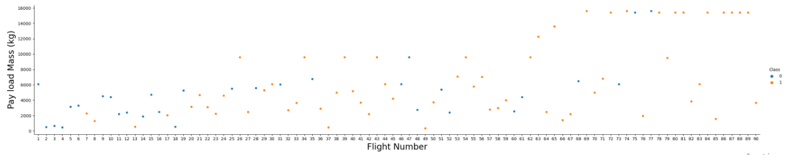
PAYLOAD vs FLIGHT NUMBER
Different launch sites have different success rates.
CCAFS LC-40, has a success rate of 60 %.
KSC LC-39A and VAFB SLC 4E has a success rate of 77%.

Slide 18
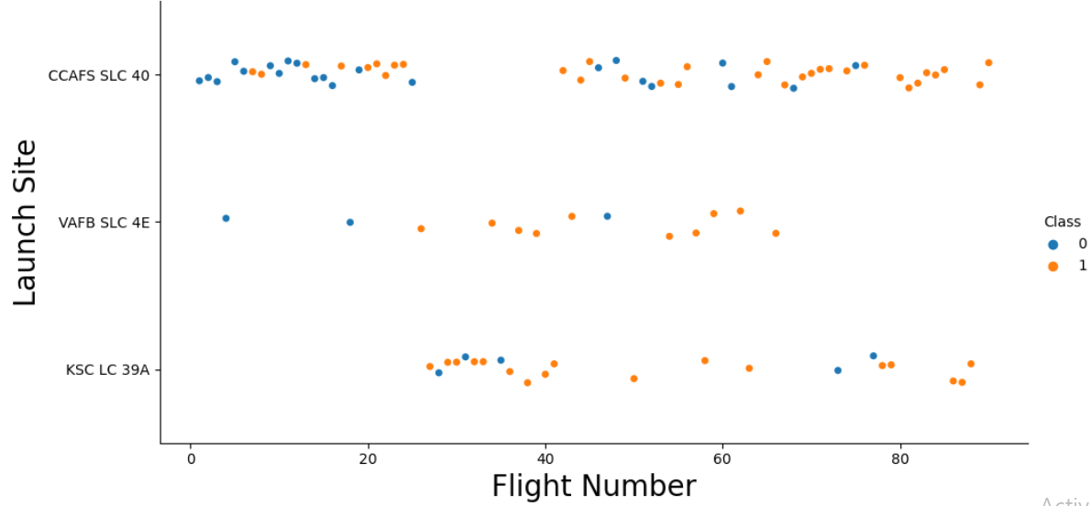
LAUNCH SITE vs FLIGHT NUMBER
The CCAFS SLC 40 has the highest success rate.
The success rates improved with more launches performed.

Slide 19
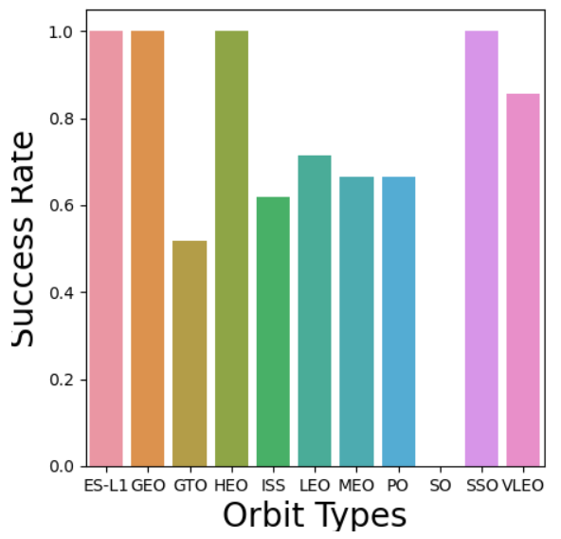
SUCCESS RATE vs ORBIT TYPE
The highest success rate is for:
ES-L1
GEO
HEO
SSO
SO orbit has 0 success rate.

Slide 20
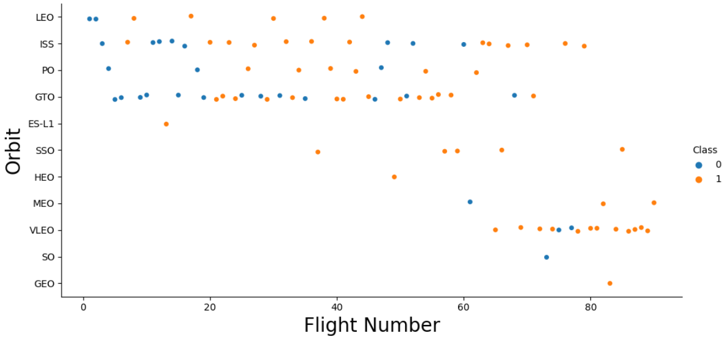
FLIGHT NUMBER vs ORBIT TYPE
An increased success rate increases success rate is observed for all the orbits.
SSO and VLEO orbits seem to have come into use recently and seem very promising.

Slide 21
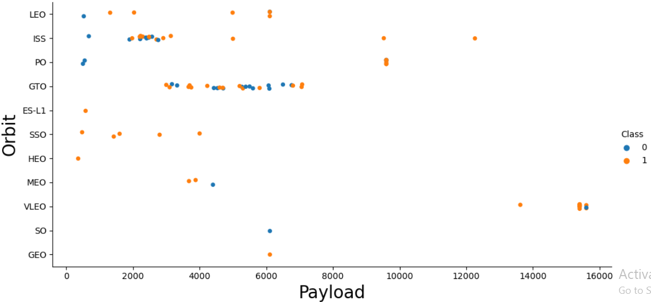
PAYLOAD vs ORBIT TYPE
With heavy payloads the success rate are more for Polar, LEO and ISS orbits.
For GTO we cannot distinguish this well as the frequency of successful and unsuccessful launches are high.

Slide 22
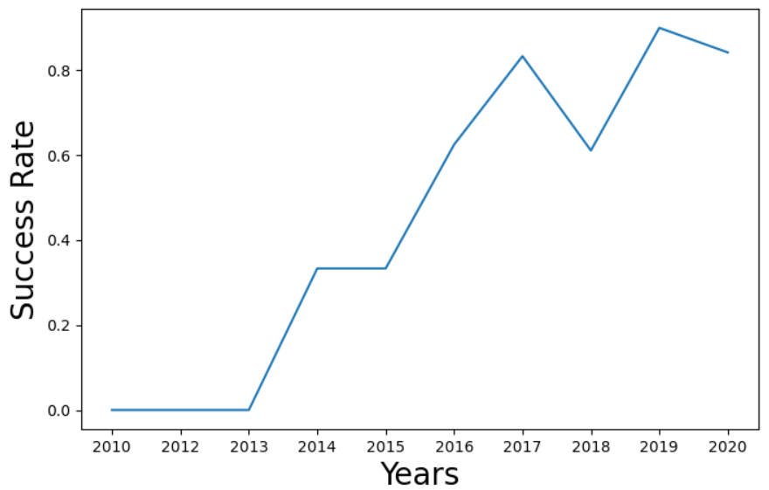
SUCCESS RATE OVER THE YEARS
The success rate clearly has improved over the years after the year 2013.

Slide 23
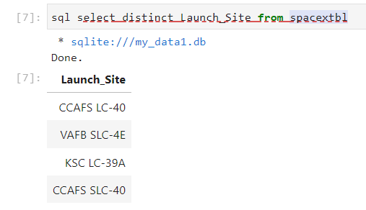
THE LAUNCH SITES
The unique launch sites are.

Slide 24
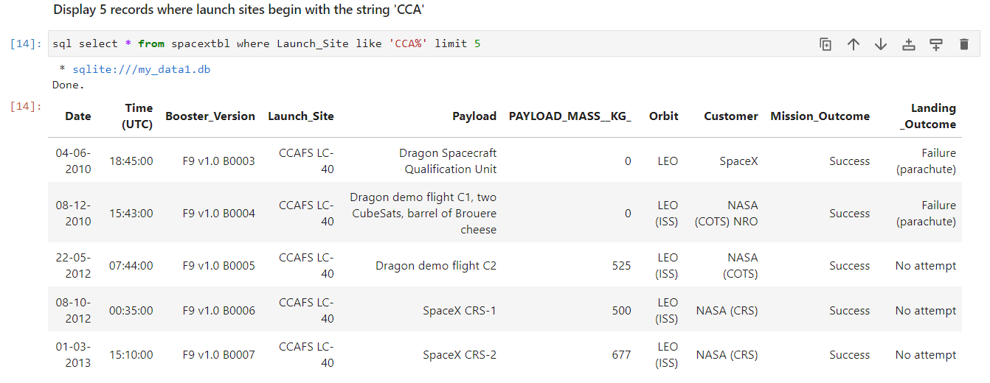
LAUNCH SITES that begin with 'CCA'
The launch missions for which the launch site name begins with "CCA".

Slide 25
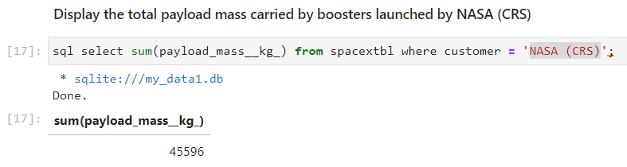
TOTAL PAYLOAD
Total payload carried by boosters launched by NASA.

Slide 26
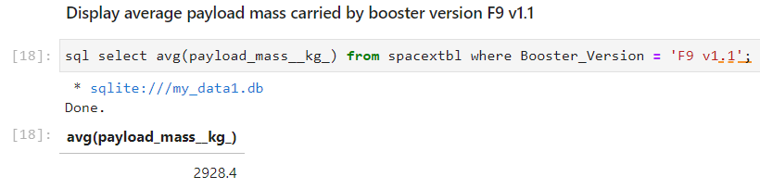
AVERAGE PAYLOAD
Average payload carried by boosters version F9 v1.1.

Slide 27

DATE OF THE FIRST SUCCESSFUL LAUNCH
Date of first successful launch for ground pad.

Slide 28
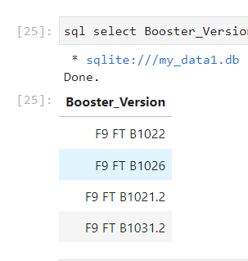
SUCESSFUL BOOSTERS IN DRONE SHIPS
Names of boosters successful in drone ship with payload mass between 4000 and 6000 kg.

Slide 29
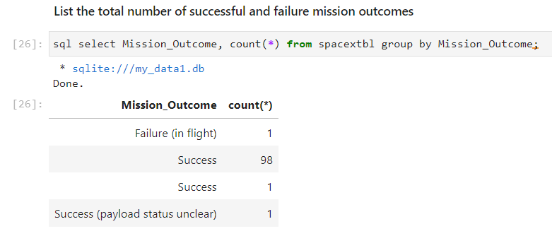
TOTAL SUCCESSFUL AND FAILED LAUNCHES
Total number of successful and failed launches.

Slide 30
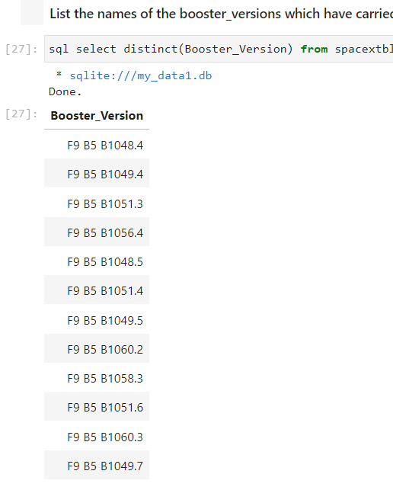
BOOSTER VERSIONS WITH MAXIMUM PAYLOAD
Booster versions with highest payload mass.

Slide 31
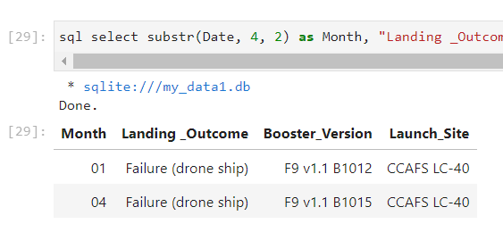
LAUNCH RECORDS FOR 2015
Failed landing outcomes in drone ship in year 2015.

Slide 32
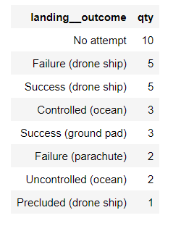
RANK OF LANDING OUTCOMES
Rank the count of successful landing_outcomes between the date 04-06-2010 and 20-03-2017 in descending order.

Slide 33
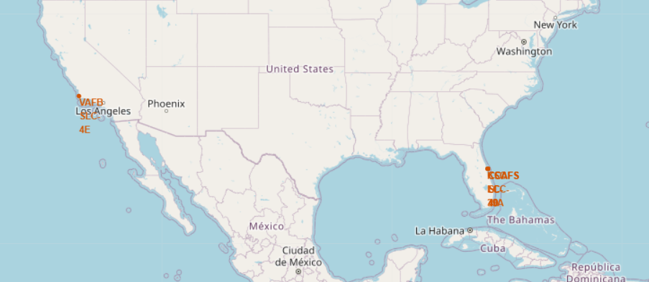
ALL LAUNCH SITES ON THE MAP
All the launch sites are away from the populated areas (cities) near the coastlines but close enough to sophisticated infrastructure like railways.

Slide 34
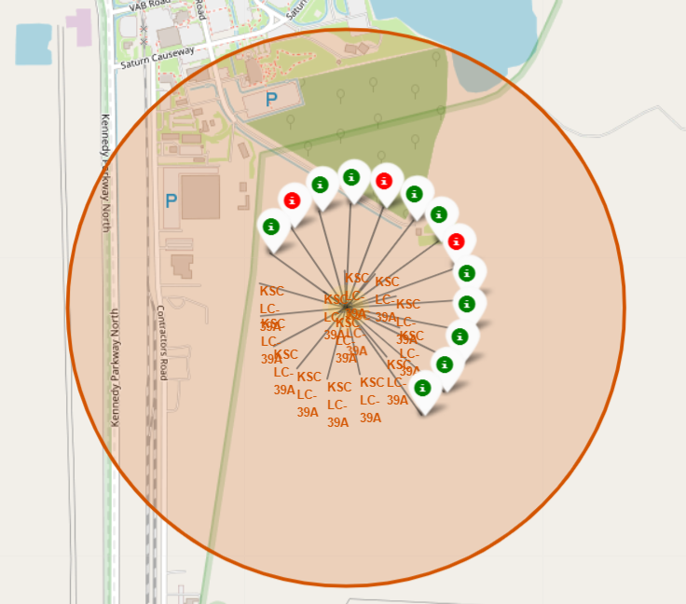
LAUNCH OUTCOMES FOR EACH SITE
This shows the KSC LC-39A launch site.
The green and red markers denote the successful and failed launch missions respectively.

Slide 35
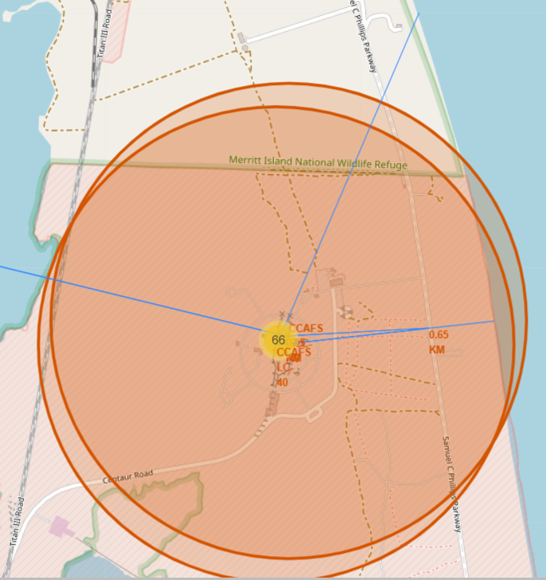
INFRASTRUCTURE AND SAFETY
Launch sites have a sophisticated infrastructure as they have good railways and roads in the vicinity.
The sites are also far away from the populated cities thus ensuring safety.

Slide 36
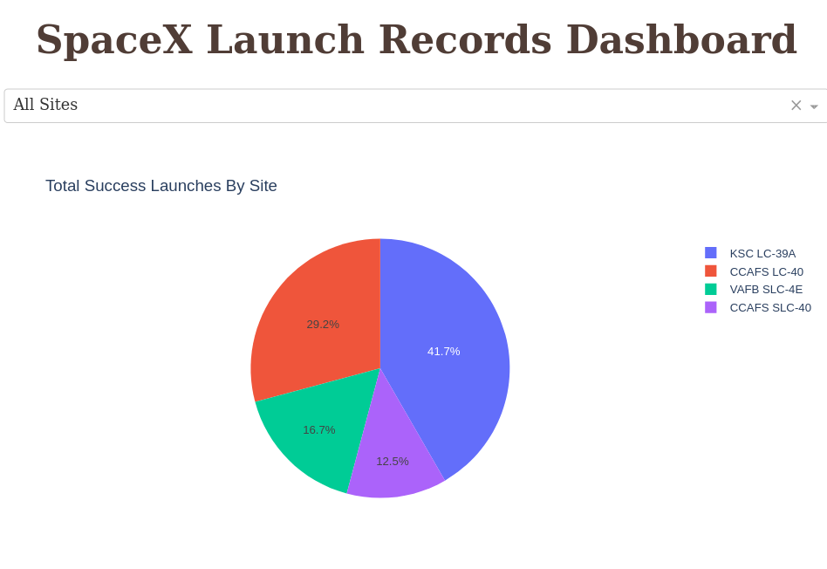
SUCCESSFUL LAUNCHES BY LAUNCH SITES
The launch sites is an important factor affecting the success of the launch mission.

Slide 37
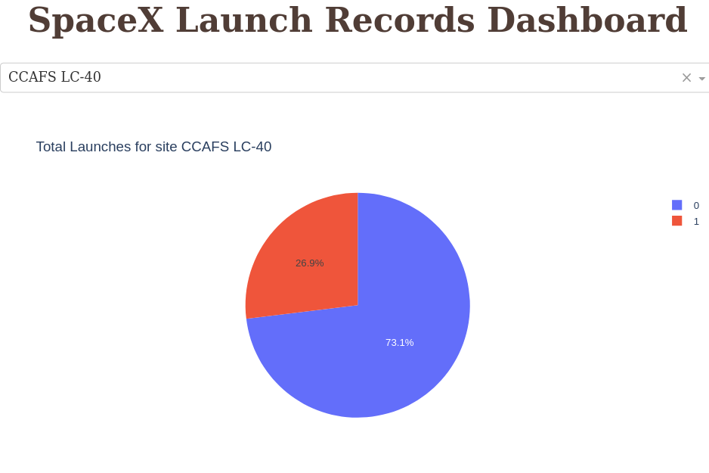
SUCCESS RATE FOR CCAFS LC-40
CCAFS LC-40 site reports 73.1 % success in all of its mission launches.

Slide 38
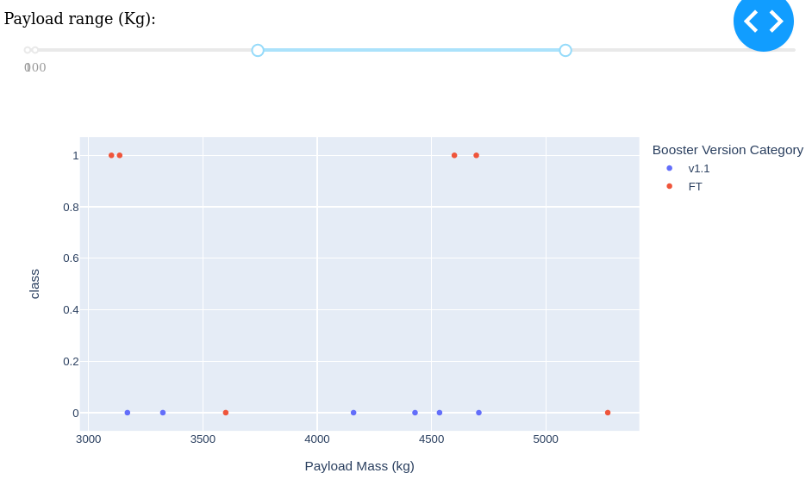
PAYLOAD AND LAUNCH OUTCOME RELATION
Payloads in the range of 3000 to 6000 kg for v1.1 booster result in failures for all launch missions.

Slide 39
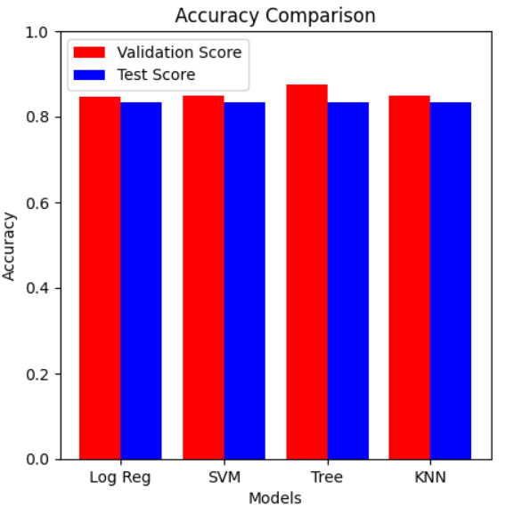
CLASSIFICATION ACCURACY OF EACH MODEL
Four classification models were used.
Logistic Regression
Support Vector Machines
Decision Trees.
K Nearest Neighbors
The test accuracies of each model were the same. 83%.
The validation accuracy of the Decision Tree model was the highest.

Slide 40
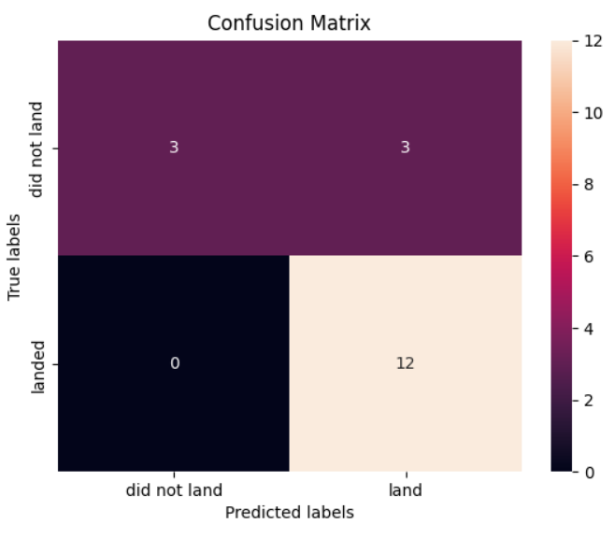
DECISION TREE CLASSIFIER
The confusion matrix of the Decision Tree shows that the model did a better job in classification.

Slide 41
CONCLUSION
Multiple data sources were analyzed throughout the process to make a final conclusion.
The site KSC LC-39A is the best site with the highest success rate for launch missions.
Launches above 6000 kg of payload mass are less risky.
The Decision Tree classifier was the best model in predicting the success and failure of the launches and thus increasing the profits.

Slide 42
APPENDIX
All the notebooks have been uploaded on GitHub – IBM Data Science Final Capstone Project.

